Slide 1
How to use
These slides are designed to be presented as is, with no edits
However you may wish to “hide” slides that aren’t relevant to your presentation (select slide – right click – hide).
Slides from this deck can be copied and pasted across to your own slide deck, where needed. To do this;
  Open both this deck and your own deck.
  Drag and drop the slides you need into your own.
  Or you can copy and paste. At the point of pasting choose keep source formatting so the design stays consistent.
Accessibility
The slides have been designed for in-person presentations, not for online use which means they are not fully accessible. For example:
  Some text appears as images.
  A video plays with important visuals but no audio description.
If there is any instance where these slides may be published online, please be aware they will not meet accessibility requirements.

Slide 2


Slide 3


Slide 4
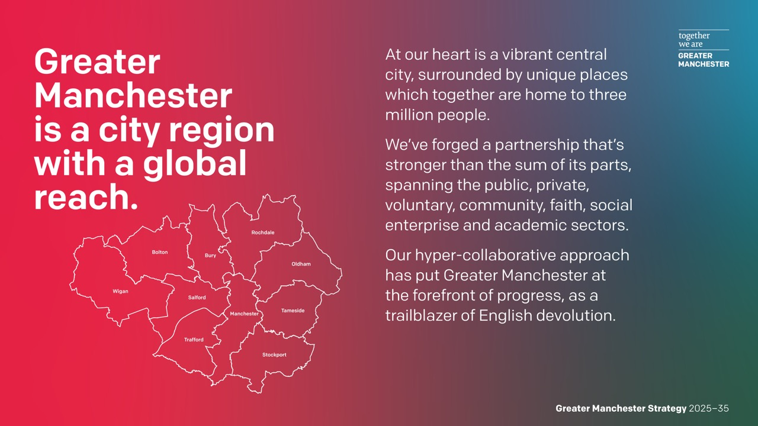

Slide 5
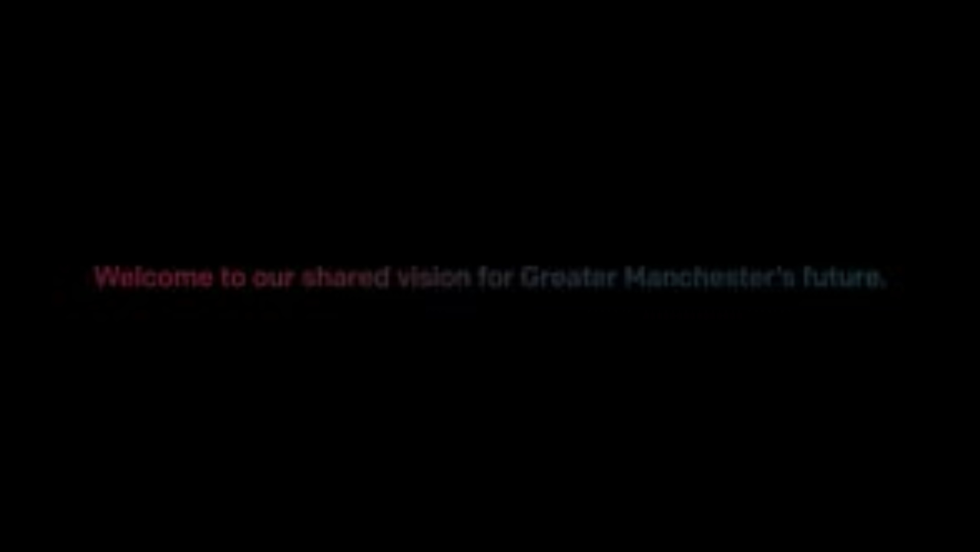
Notes:
Over a decade of devolution, we have achieved so much together. This video showcases some of those key achievements, including all our buses now being under local control.

Slide 6
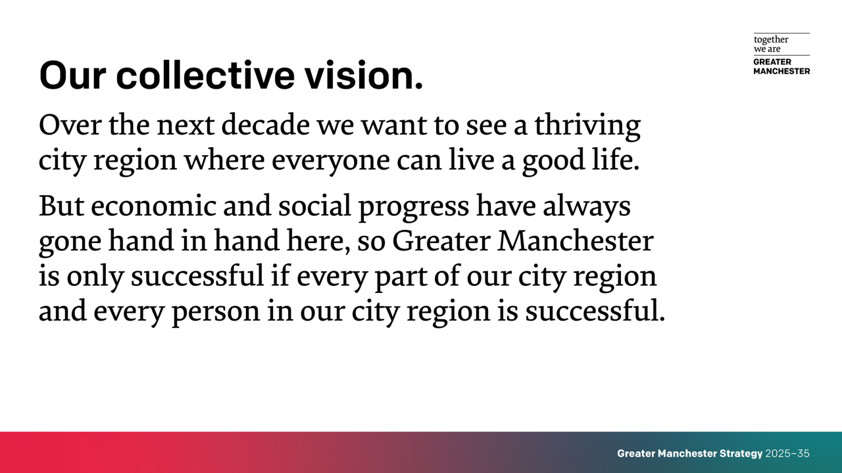

Slide 7
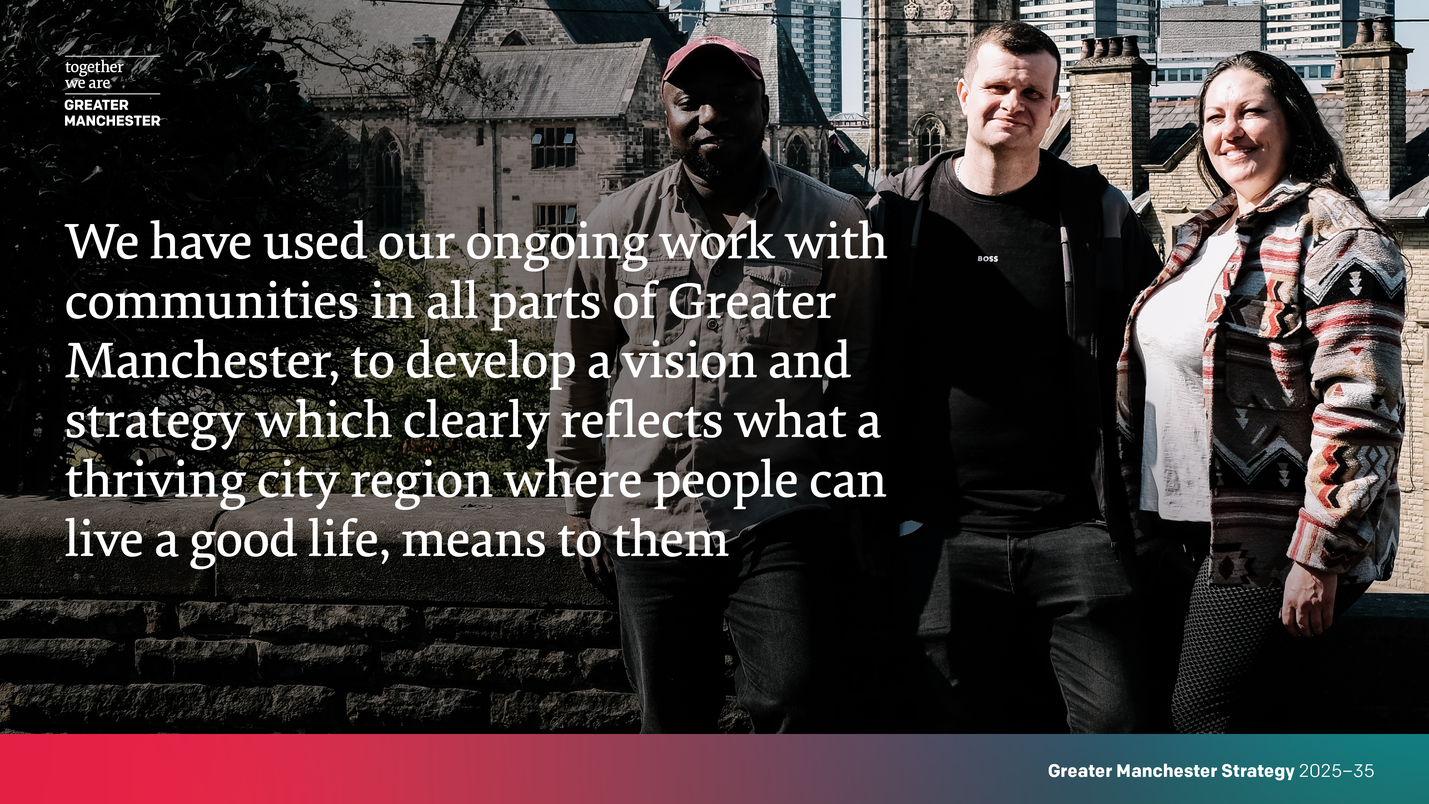

Slide 8

Notes:
VIDEO: People from across the city-region reflect on what the Greater Manchester Strategy’s vision meant to them.

Slide 9
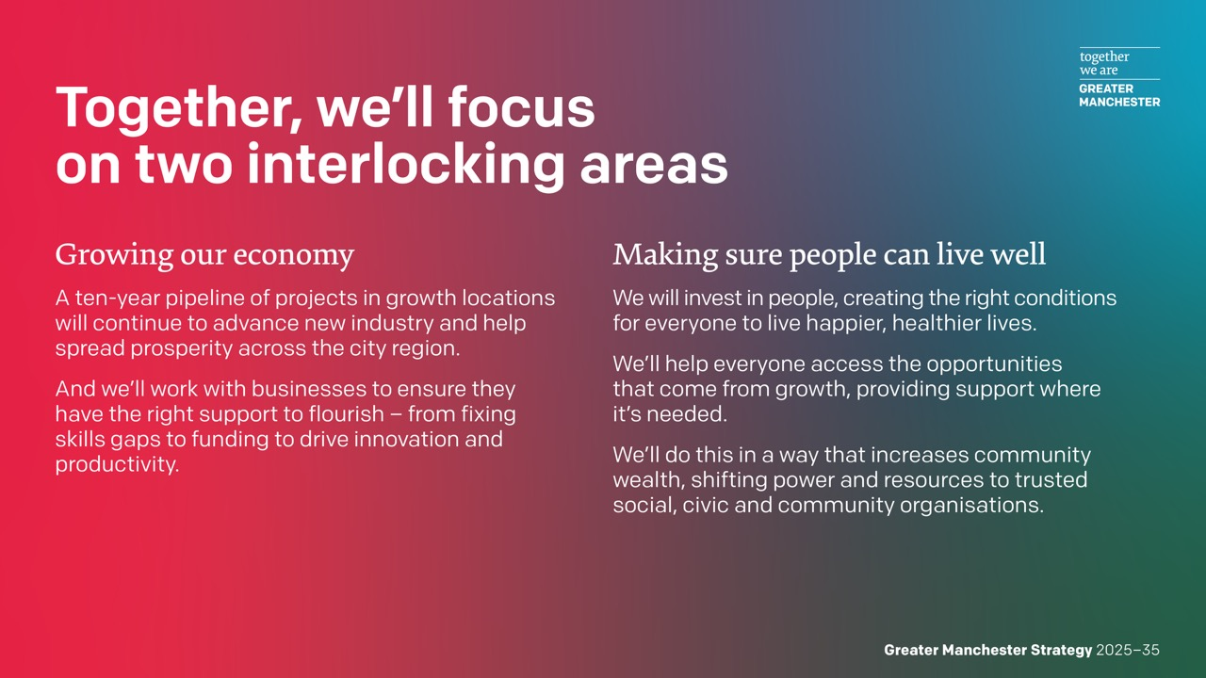

Slide 10
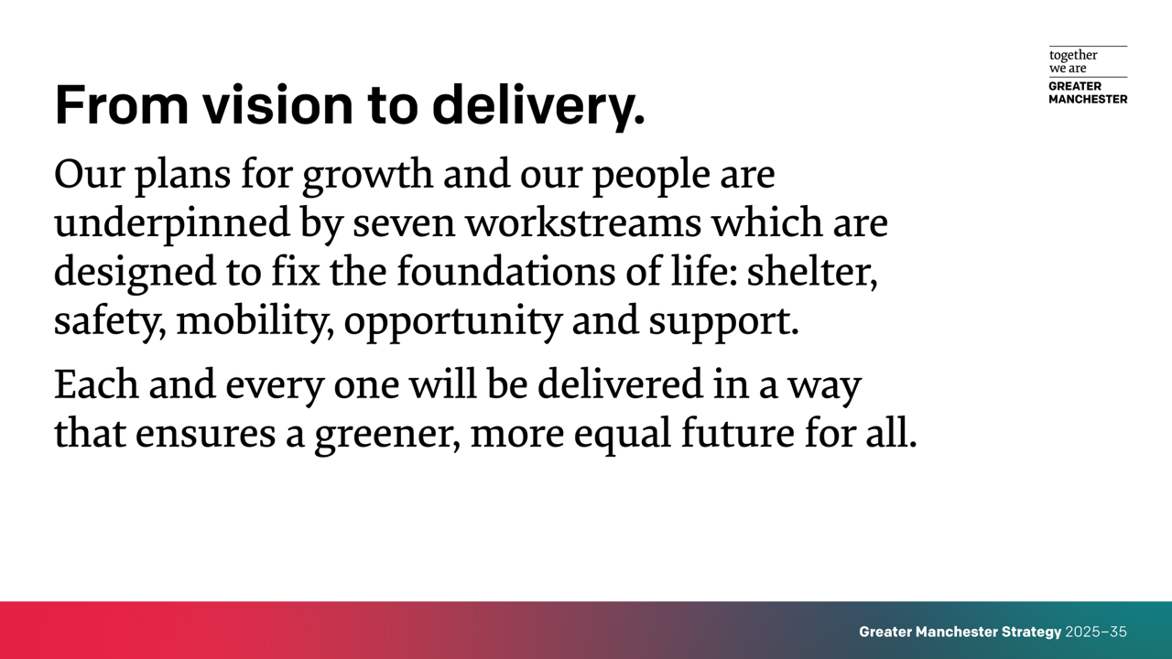

Slide 11
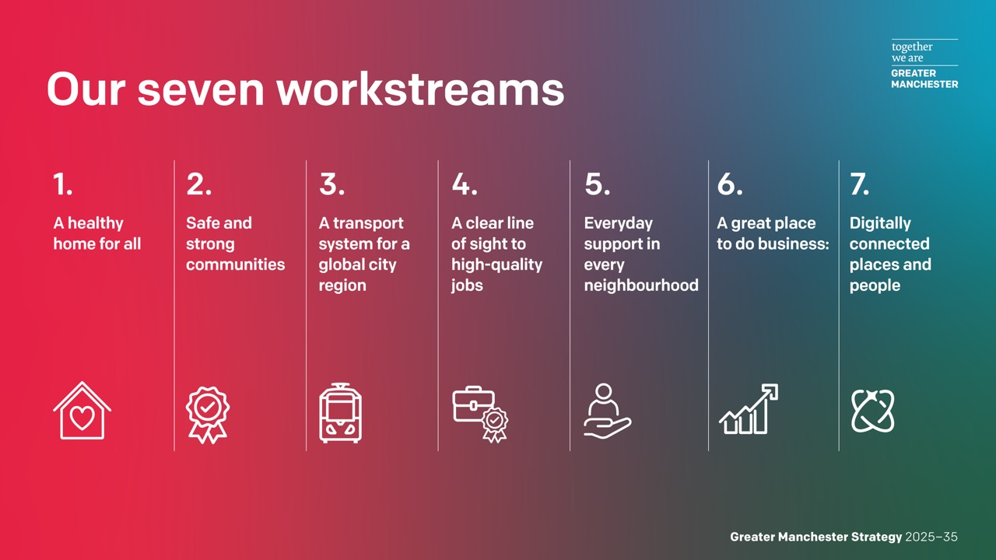

Slide 12
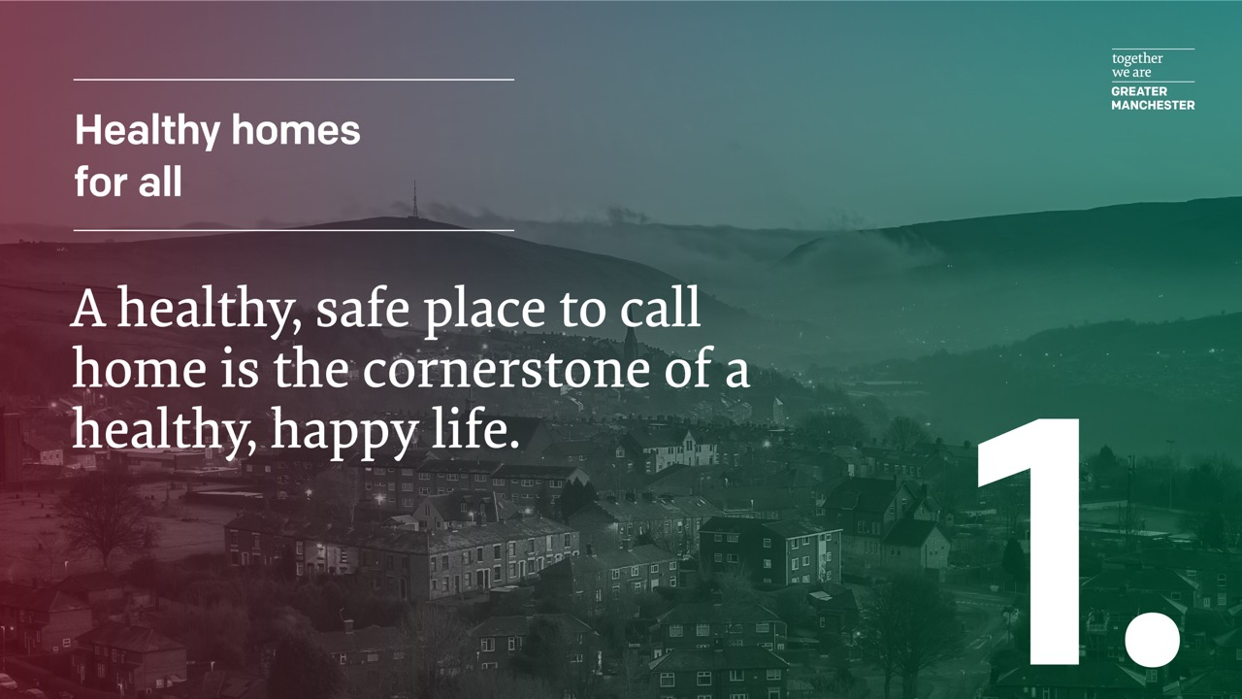

Slide 13


Slide 14
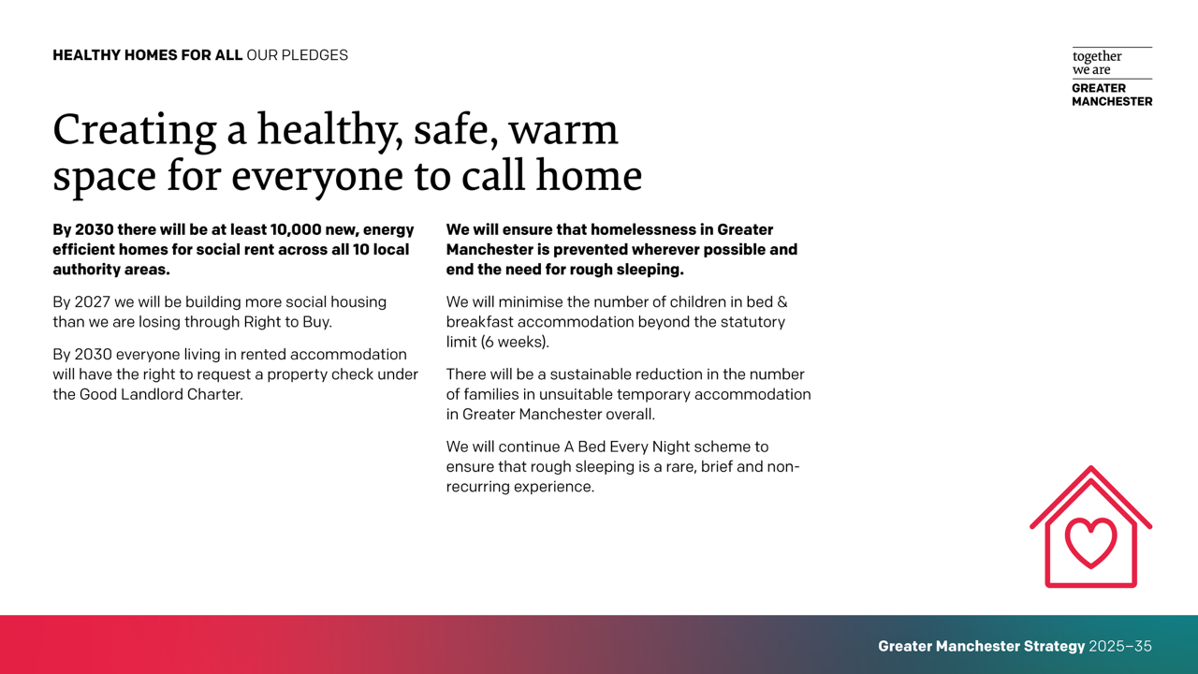

Slide 15
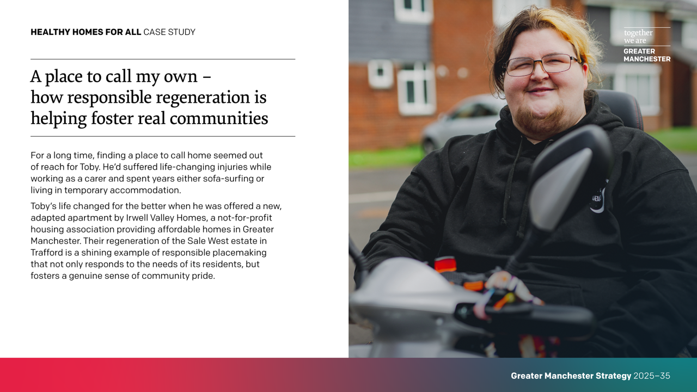

Slide 16
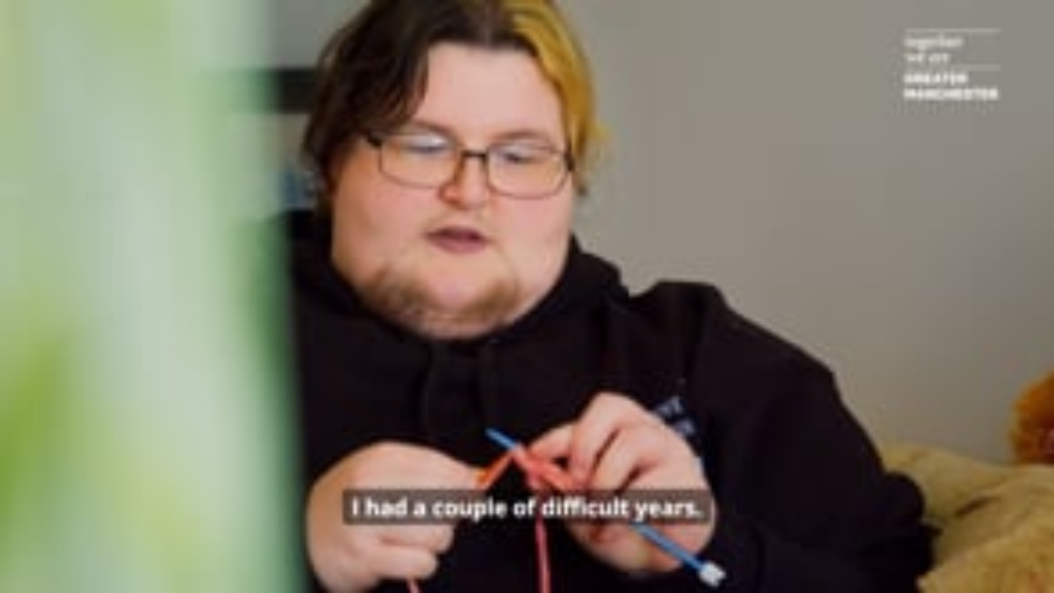
Notes:
VIDEO: For a long time, finding a place to call home seemed out of reach for Toby. He'd suffered life-changing injuries while working as a carer and spent years sofa-surfing before a spell living in supported housing. Toby’s life changed when he was offered a new, adaptable-ready apartment by Irwell Valley Homes, a not-for-profit housing association providing affordable homes in Greater Manchester. Their regeneration of the Sale West estate in Trafford is a shining example of responsible placemaking that not only responds to the needs of its residents, but fosters a genuine sense of community pride.

Slide 17
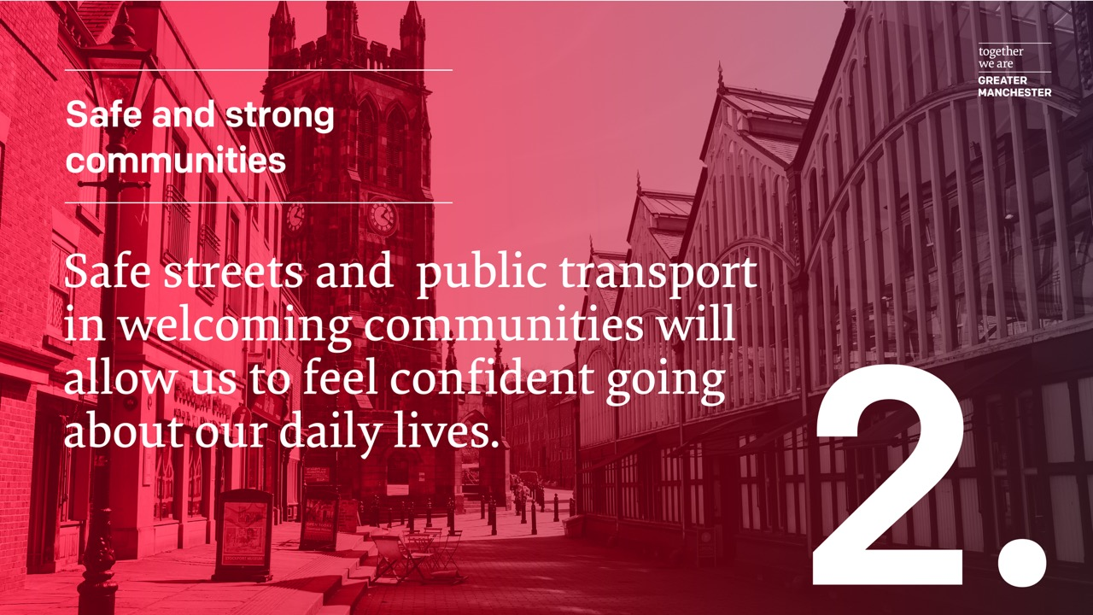

Slide 18


Slide 19


Slide 20
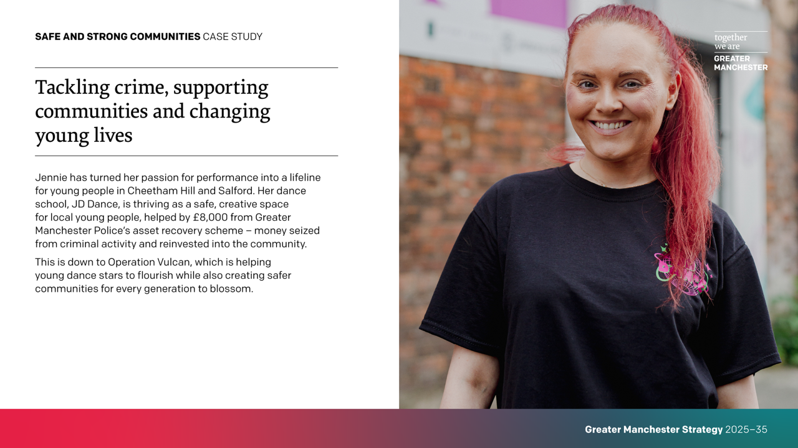

Slide 21
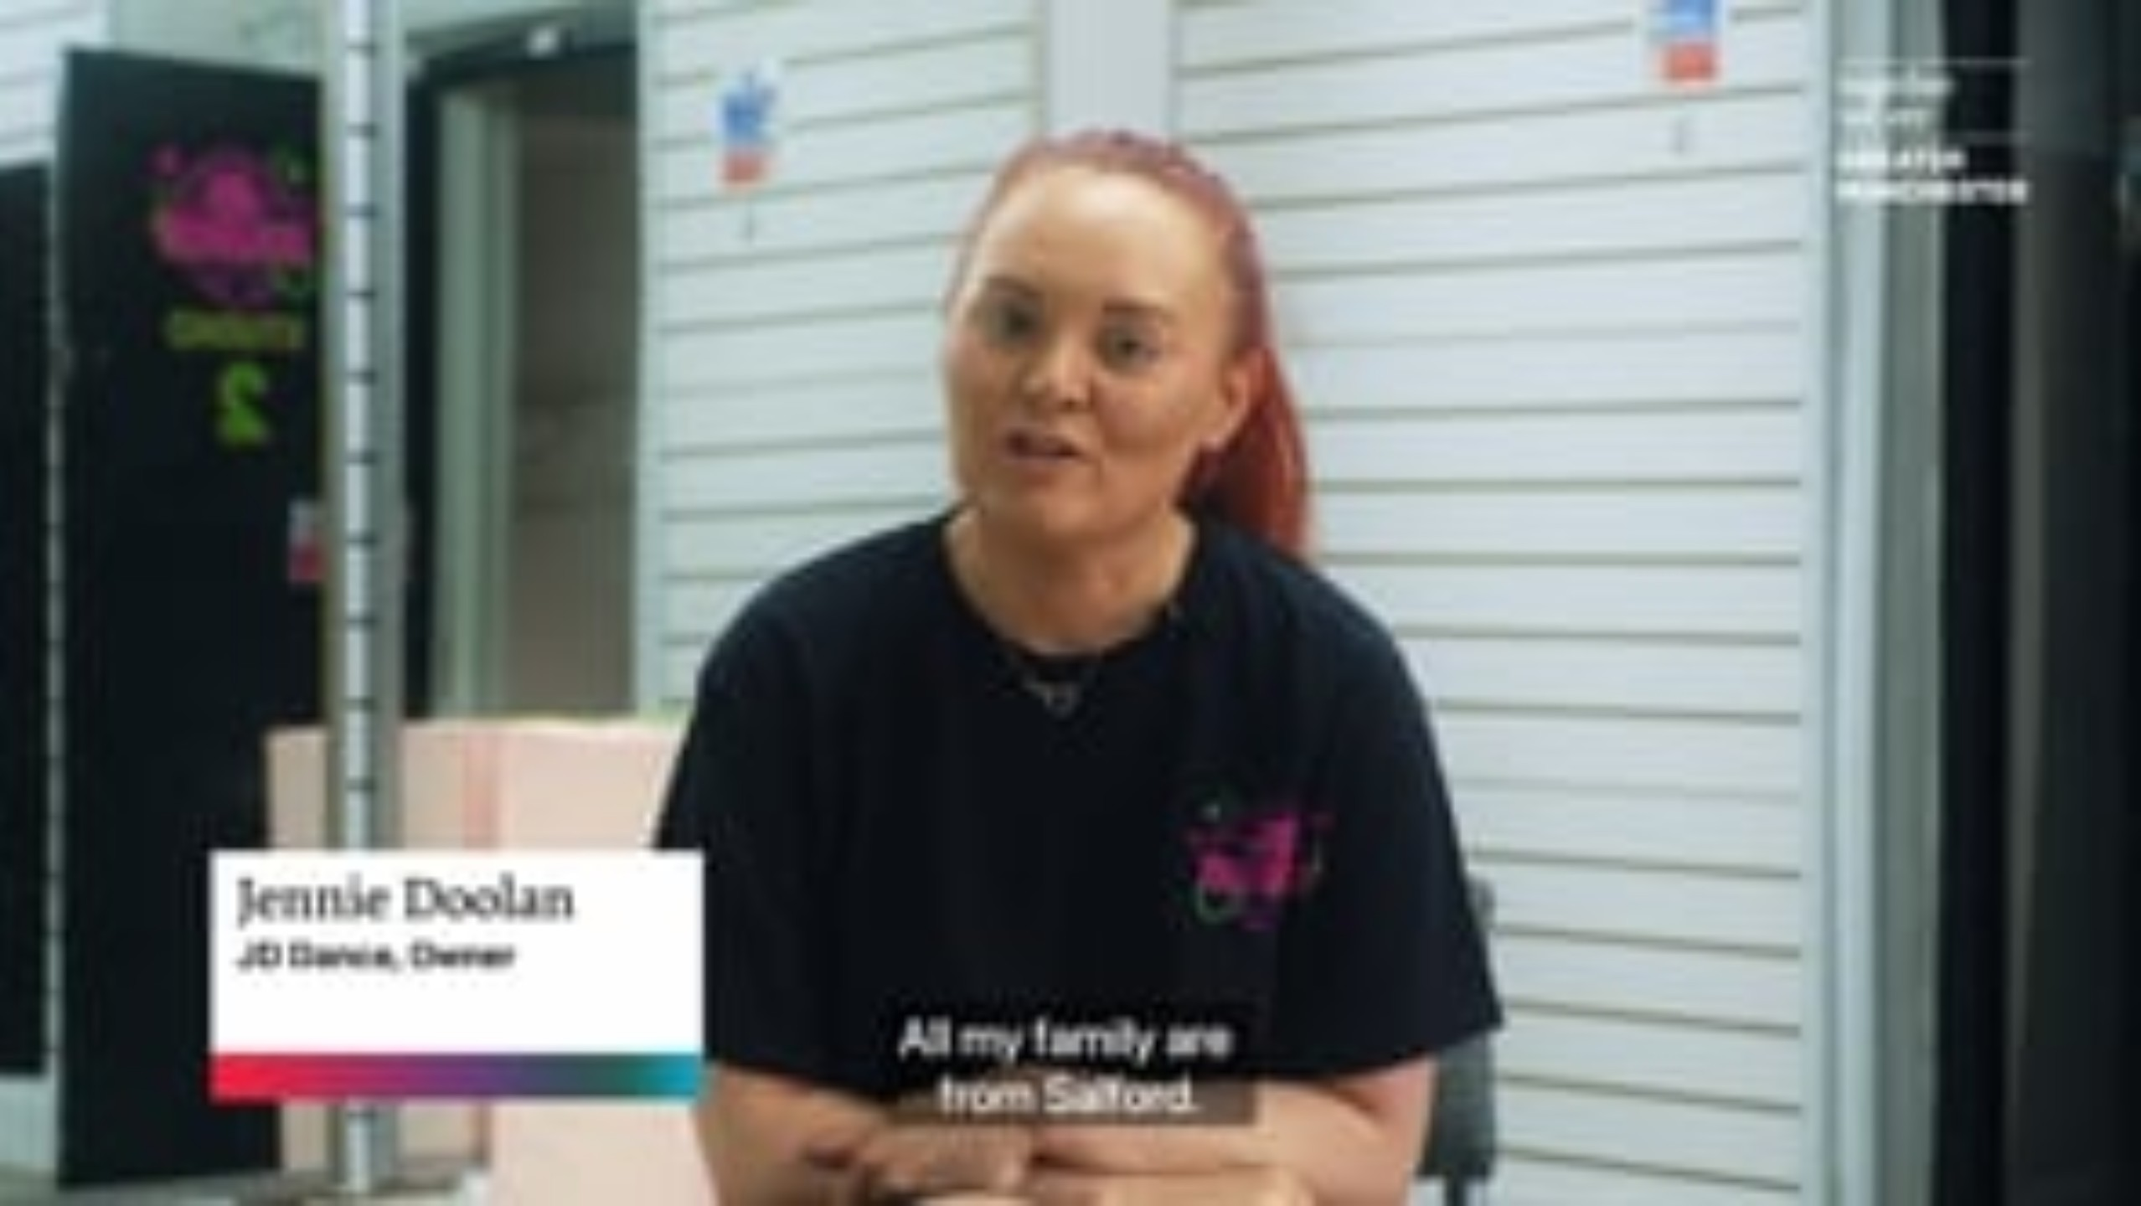
Notes:
VIDEO: Jennie has turned her passion for performance into a lifeline for young people in Cheetham Hill and Salford. Her dance school, JD Dance, is thriving as a safe, creative space for local young people, helped by £8,000 from Greater Manchester Police’s asset recovery scheme – money seized from criminal activity and reinvested into the community. Follow Jennie and her students as she shares how GMP’s Operation Vulcan has helped her young dance stars flourish, with Superintendent Jen Kelly explaining how cutting crime creates safer communities for every generation to blossom.

Slide 22
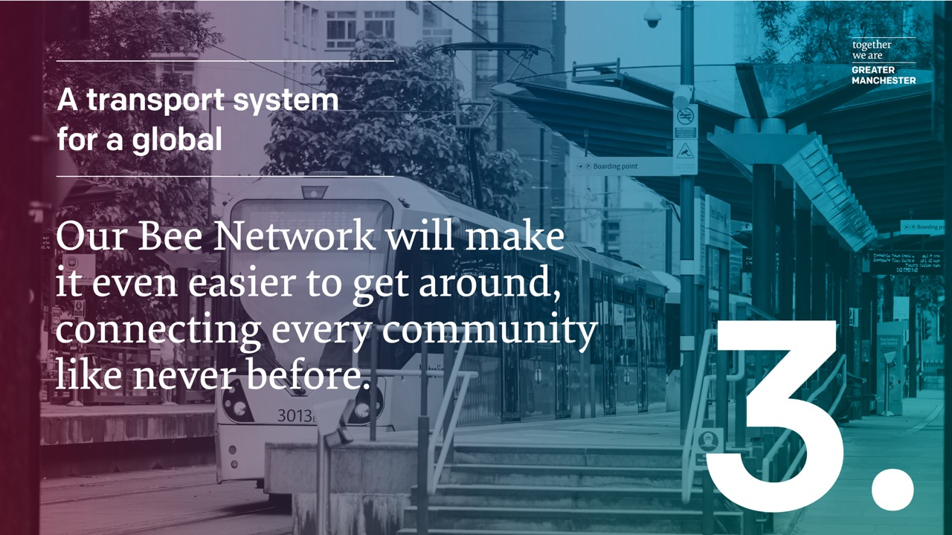

Slide 23
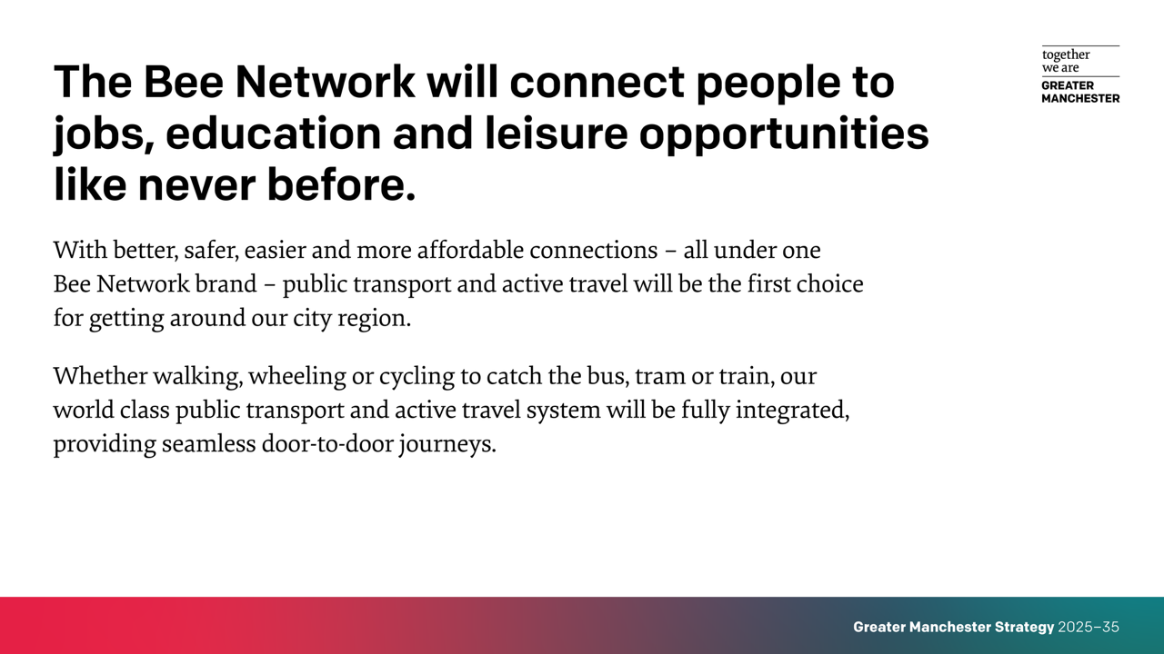

Slide 24
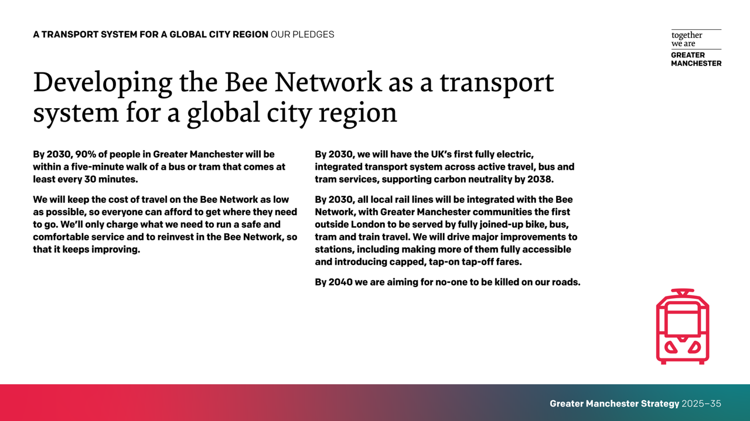

Slide 25
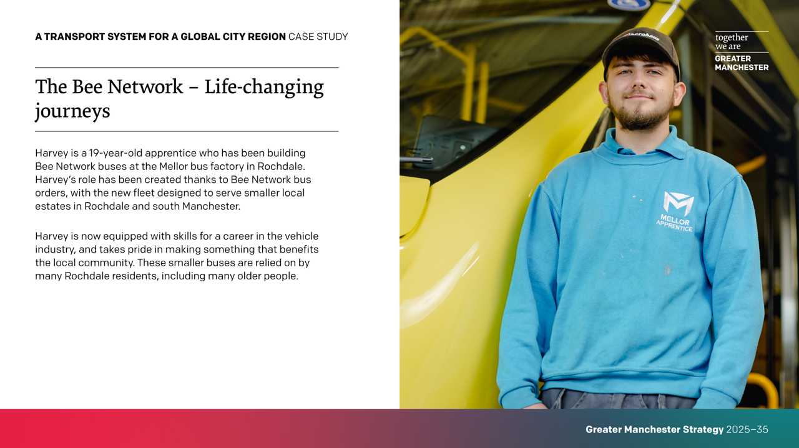

Slide 26
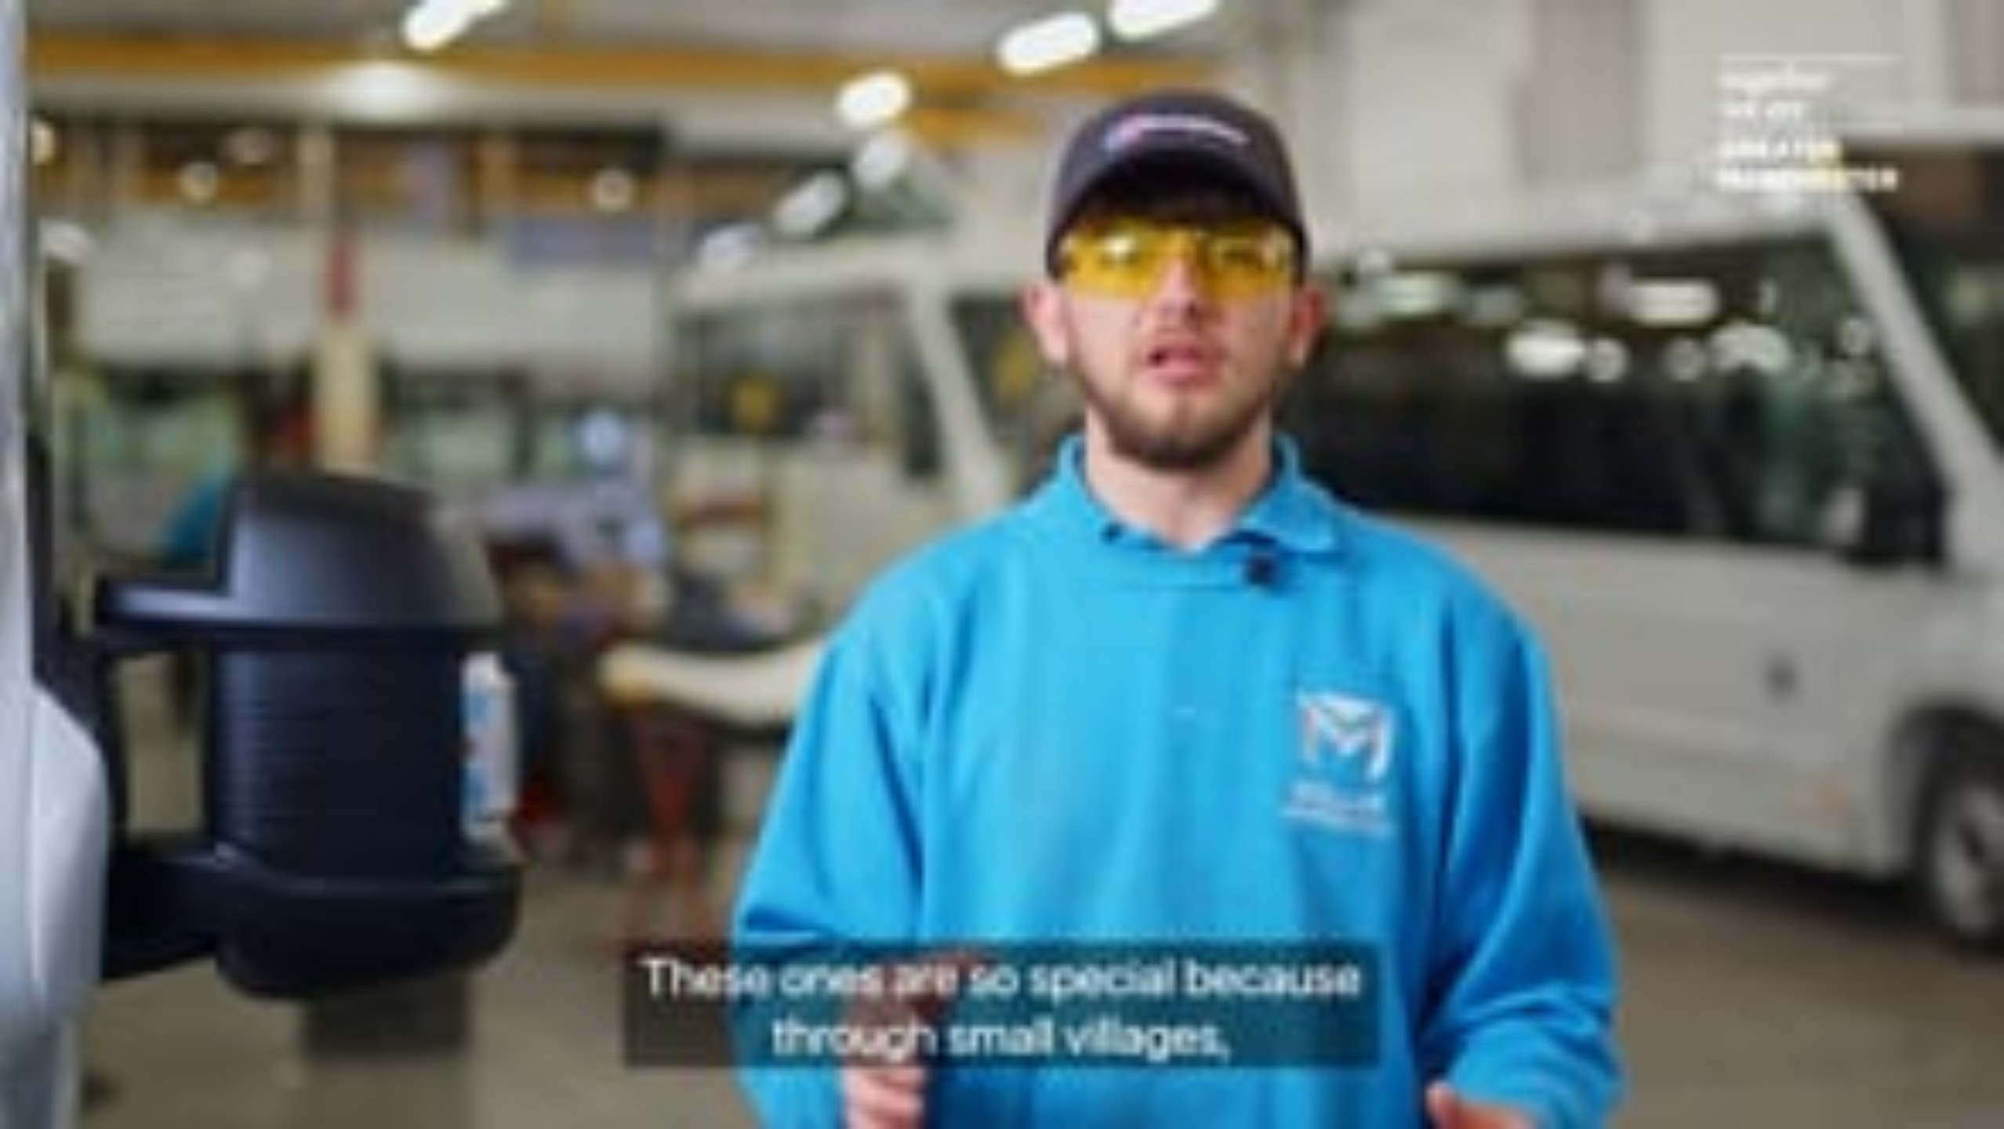
Notes:
VIDEO: Meet Harvey, a 19-year-old apprentice who has been building Bee Network buses at the Mellor bus factory in Rochdale. Harvey’s role has been created thanks to Bee Network bus orders, with the new fleet designed to serve smaller local estates in Rochdale and south Manchester. Harvey, who is now equipped with skills for a career in the vehicle industry, speaks of his pride in making something that benefits the local community. Meanwhile Rochdale residents who rely on these smaller buses – including 91-year-old Patrick – describe them as essential for getting around.

Slide 27
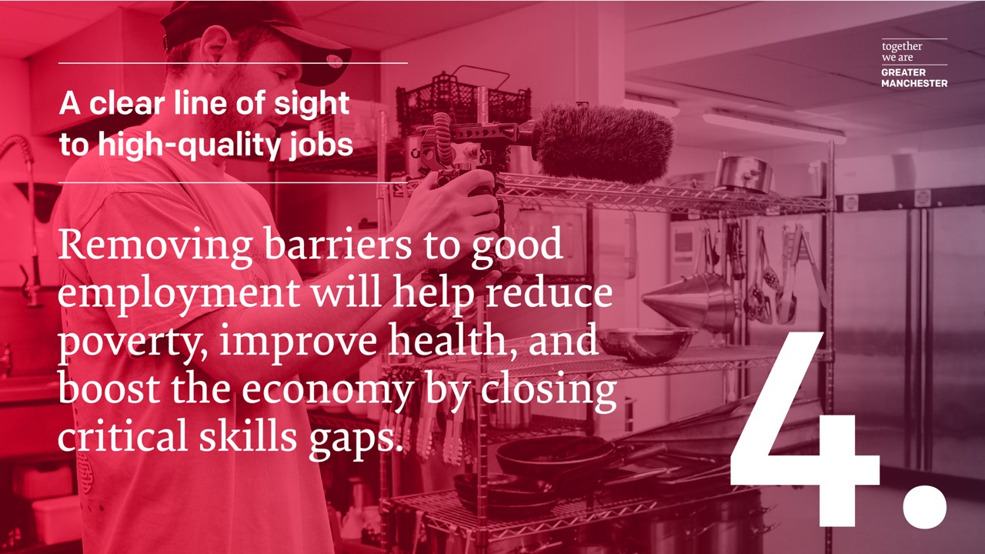

Slide 28
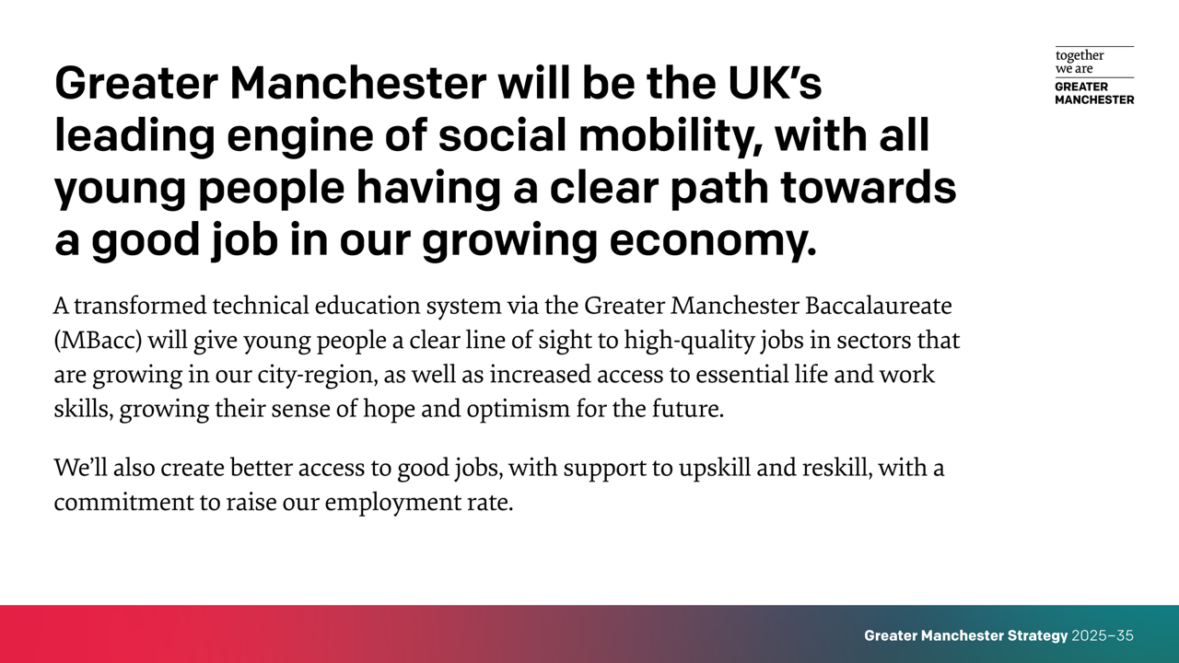

Slide 29
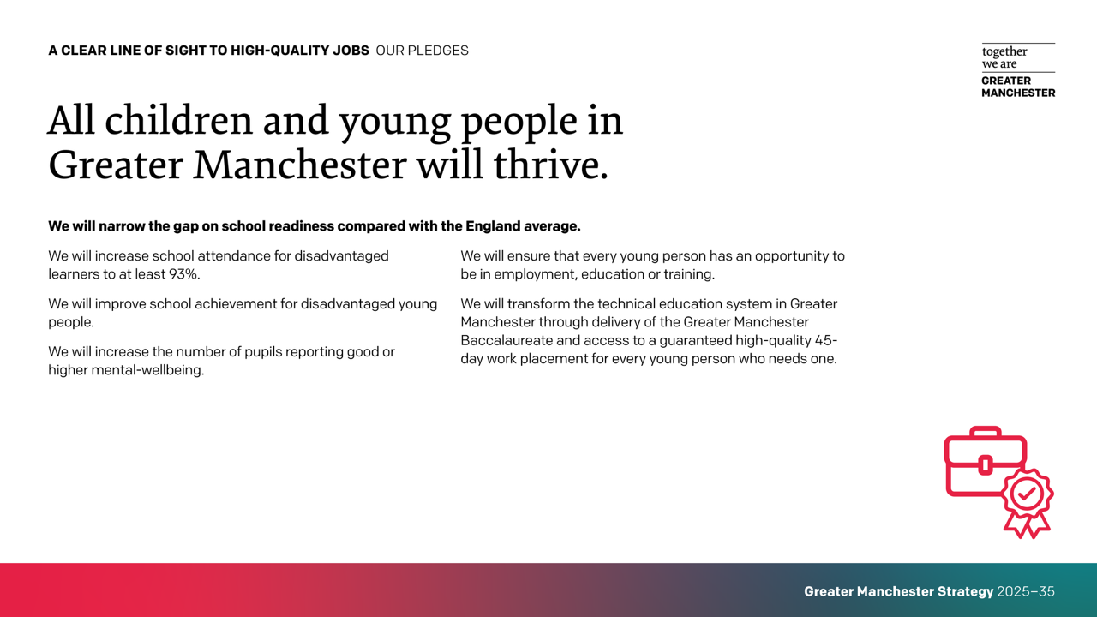

Slide 30
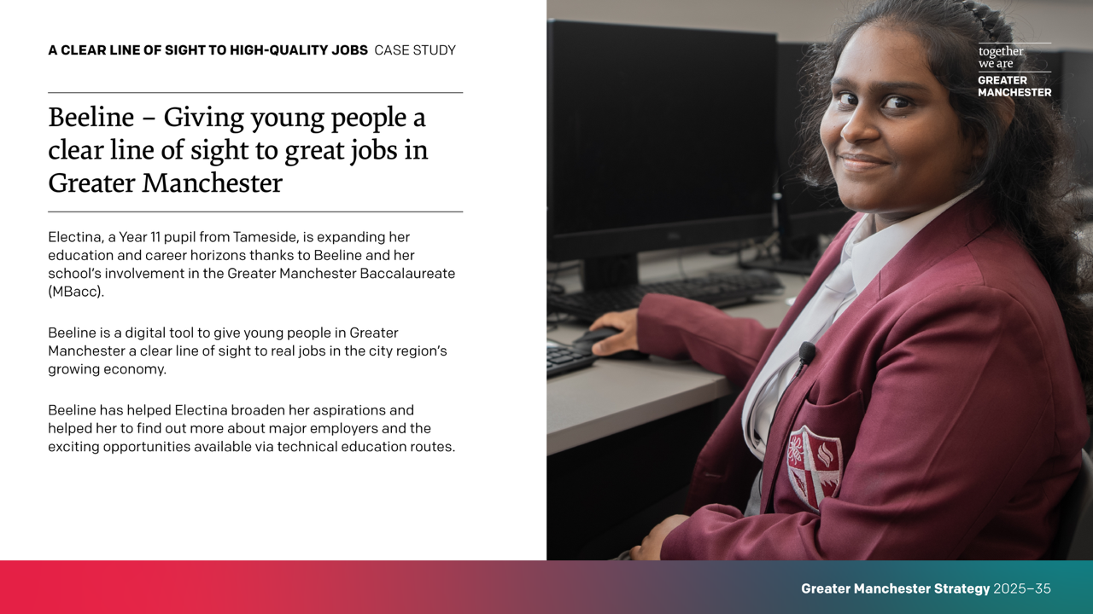

Slide 31
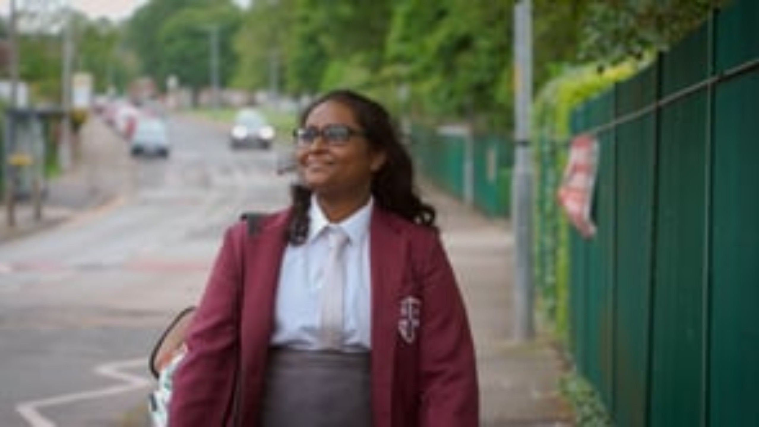
Notes:
VIDEO: Electina, a year 11 pupil from Tameside, is expanding her education and career horizons thanks to Beeline and her school’s involvement in the Greater Manchester Baccalaureate (Mbacc). Beeline is digital tool to give young people in Greater Manchester a clear line of sight to real jobs in the city-region's growing economy. Follow Electina as she tells us how Beeline has helped her broaden her aspirations and joins her teacher on a trip into Manchester city centre to meet one of the big employers already offering exciting opportunities via technical education routes.

Slide 32
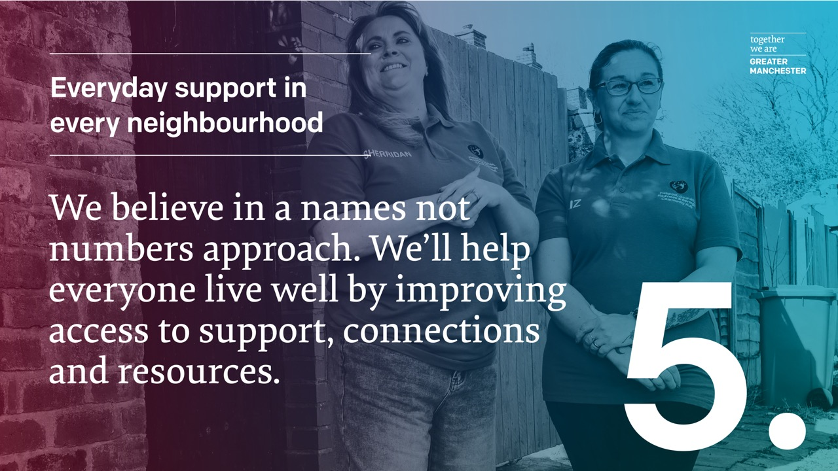

Slide 33
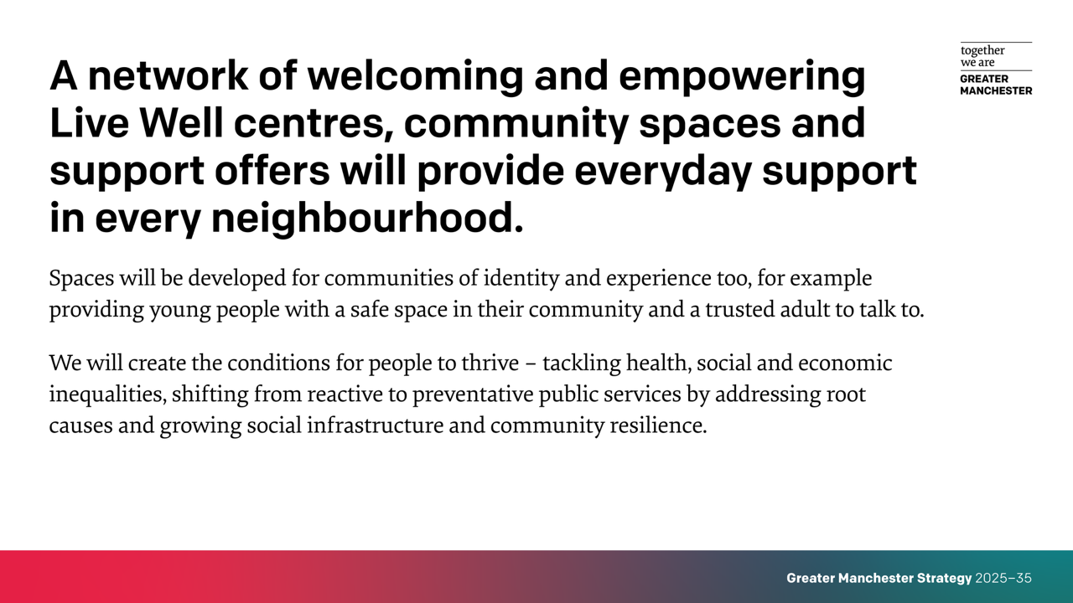

Slide 34
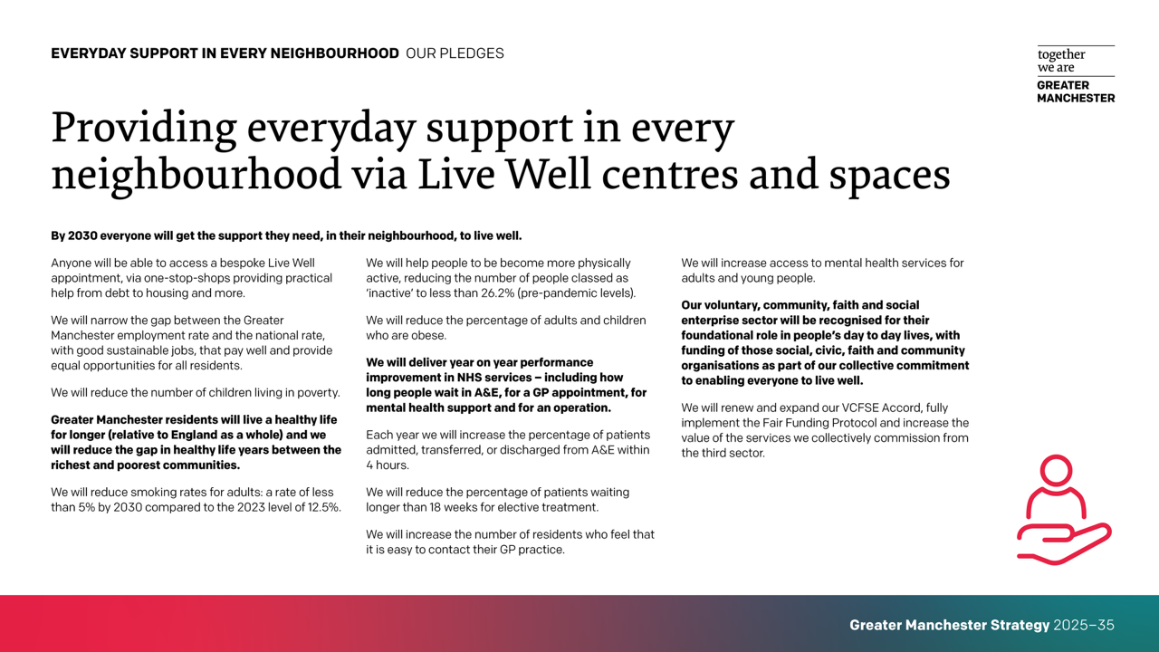

Slide 35
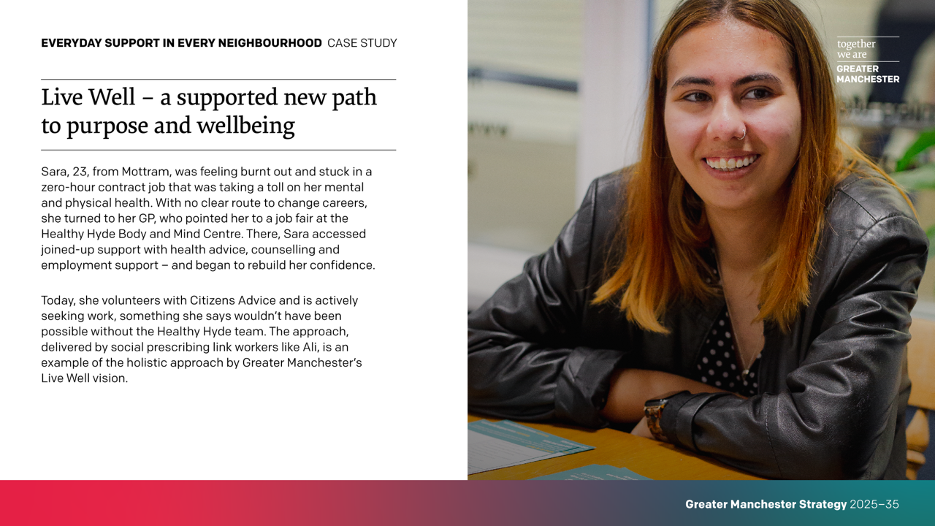

Slide 36
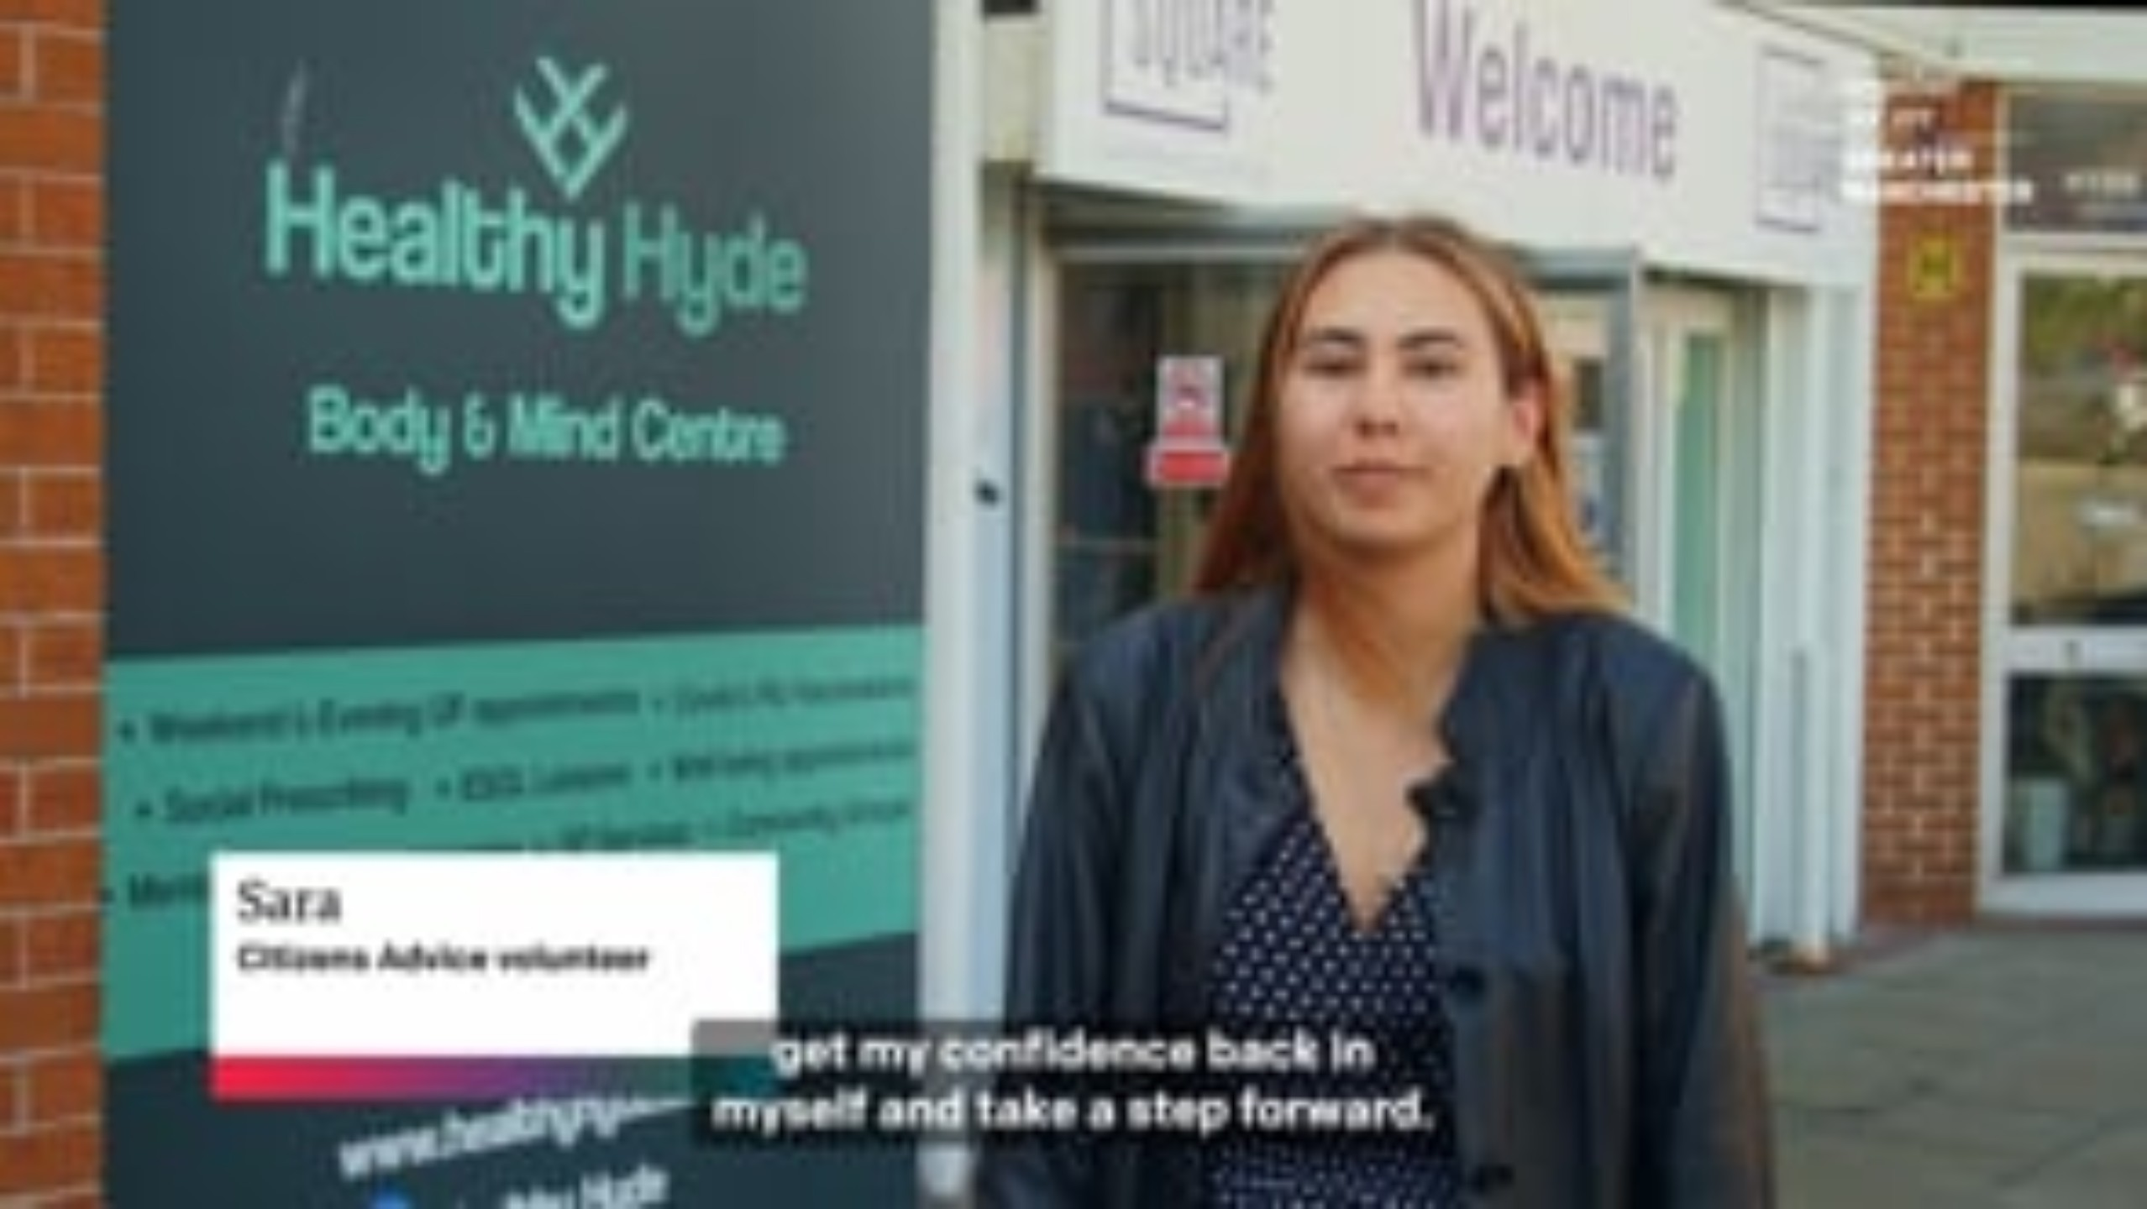
Notes:
VIDEO: Sara was feeling burnt out and stuck in a zero-hour contract job that was taking a toll on her mental and physical health. With no clear route to change careers, she turned to her GP, who pointed her to a job fair at the Healthy Hyde Body and Mind Centre. There, Sara accessed joined-up support with health advice, counselling and employment support – and began to rebuild her confidence. Today, she volunteers with Citizens Advice and is actively seeking work, something she says wouldn’t have been possible without the Healthy Hyde team. The approach, delivered by social prescribing link workers like Ali, is an example of the holistic approach by Greater Manchester’s Live Well vision.

Slide 37
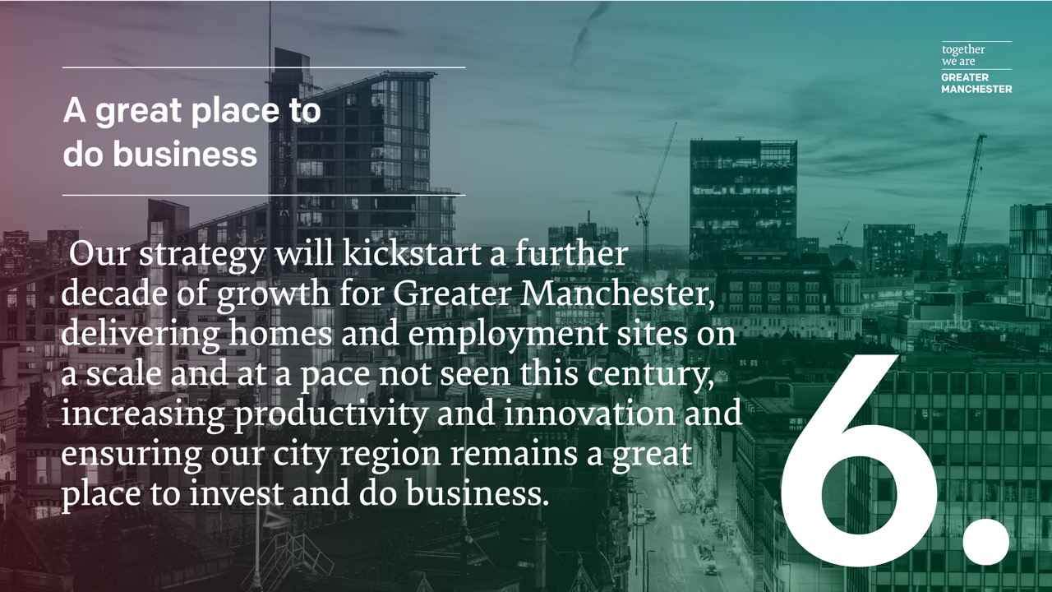

Slide 38
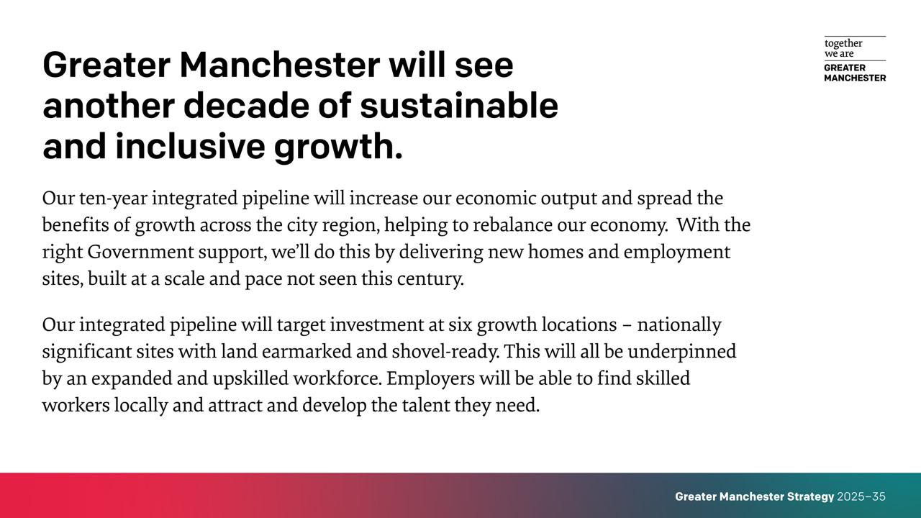

Slide 39
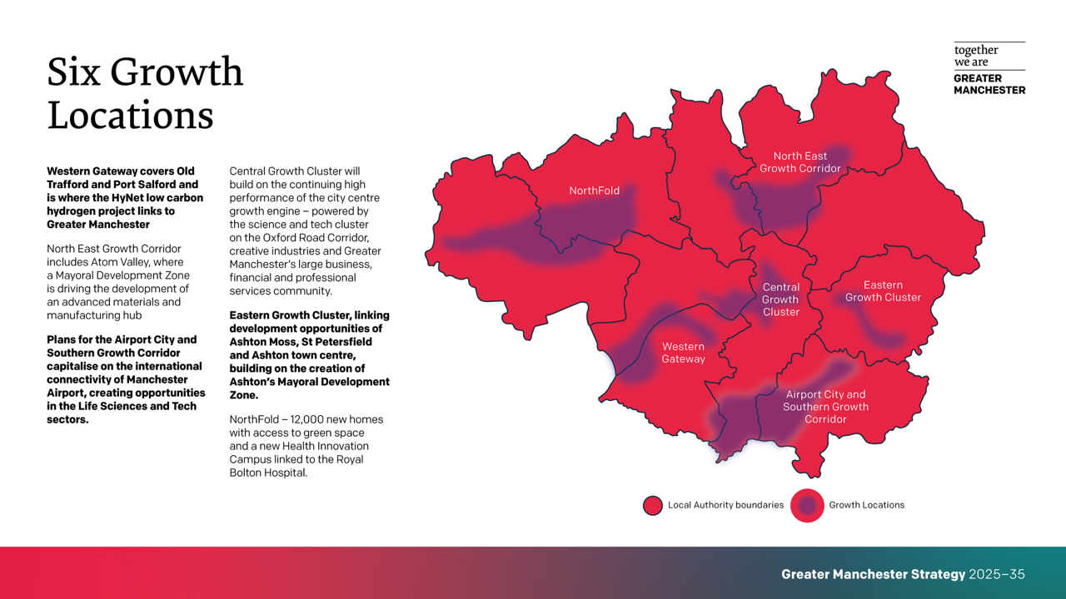

Slide 40
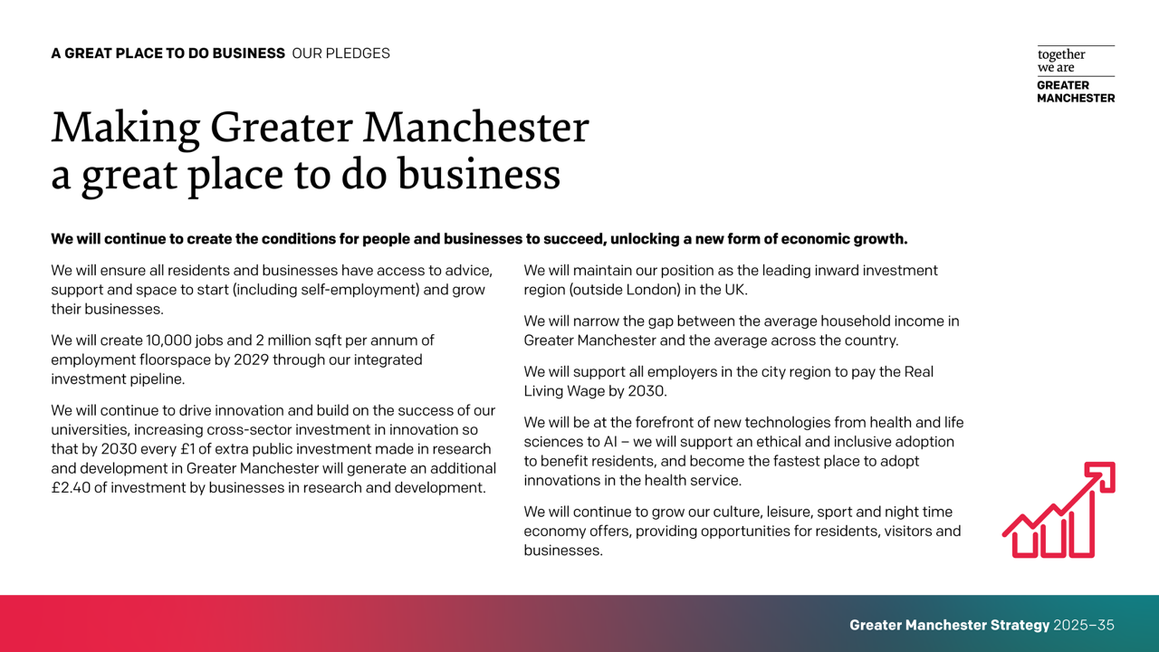

Slide 41
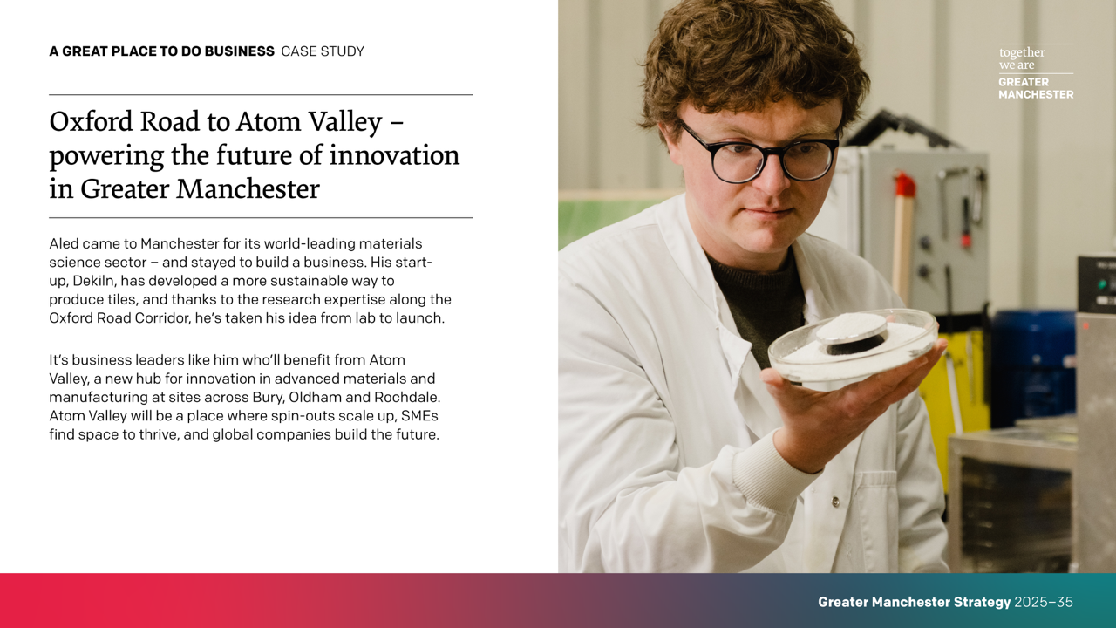

Slide 42
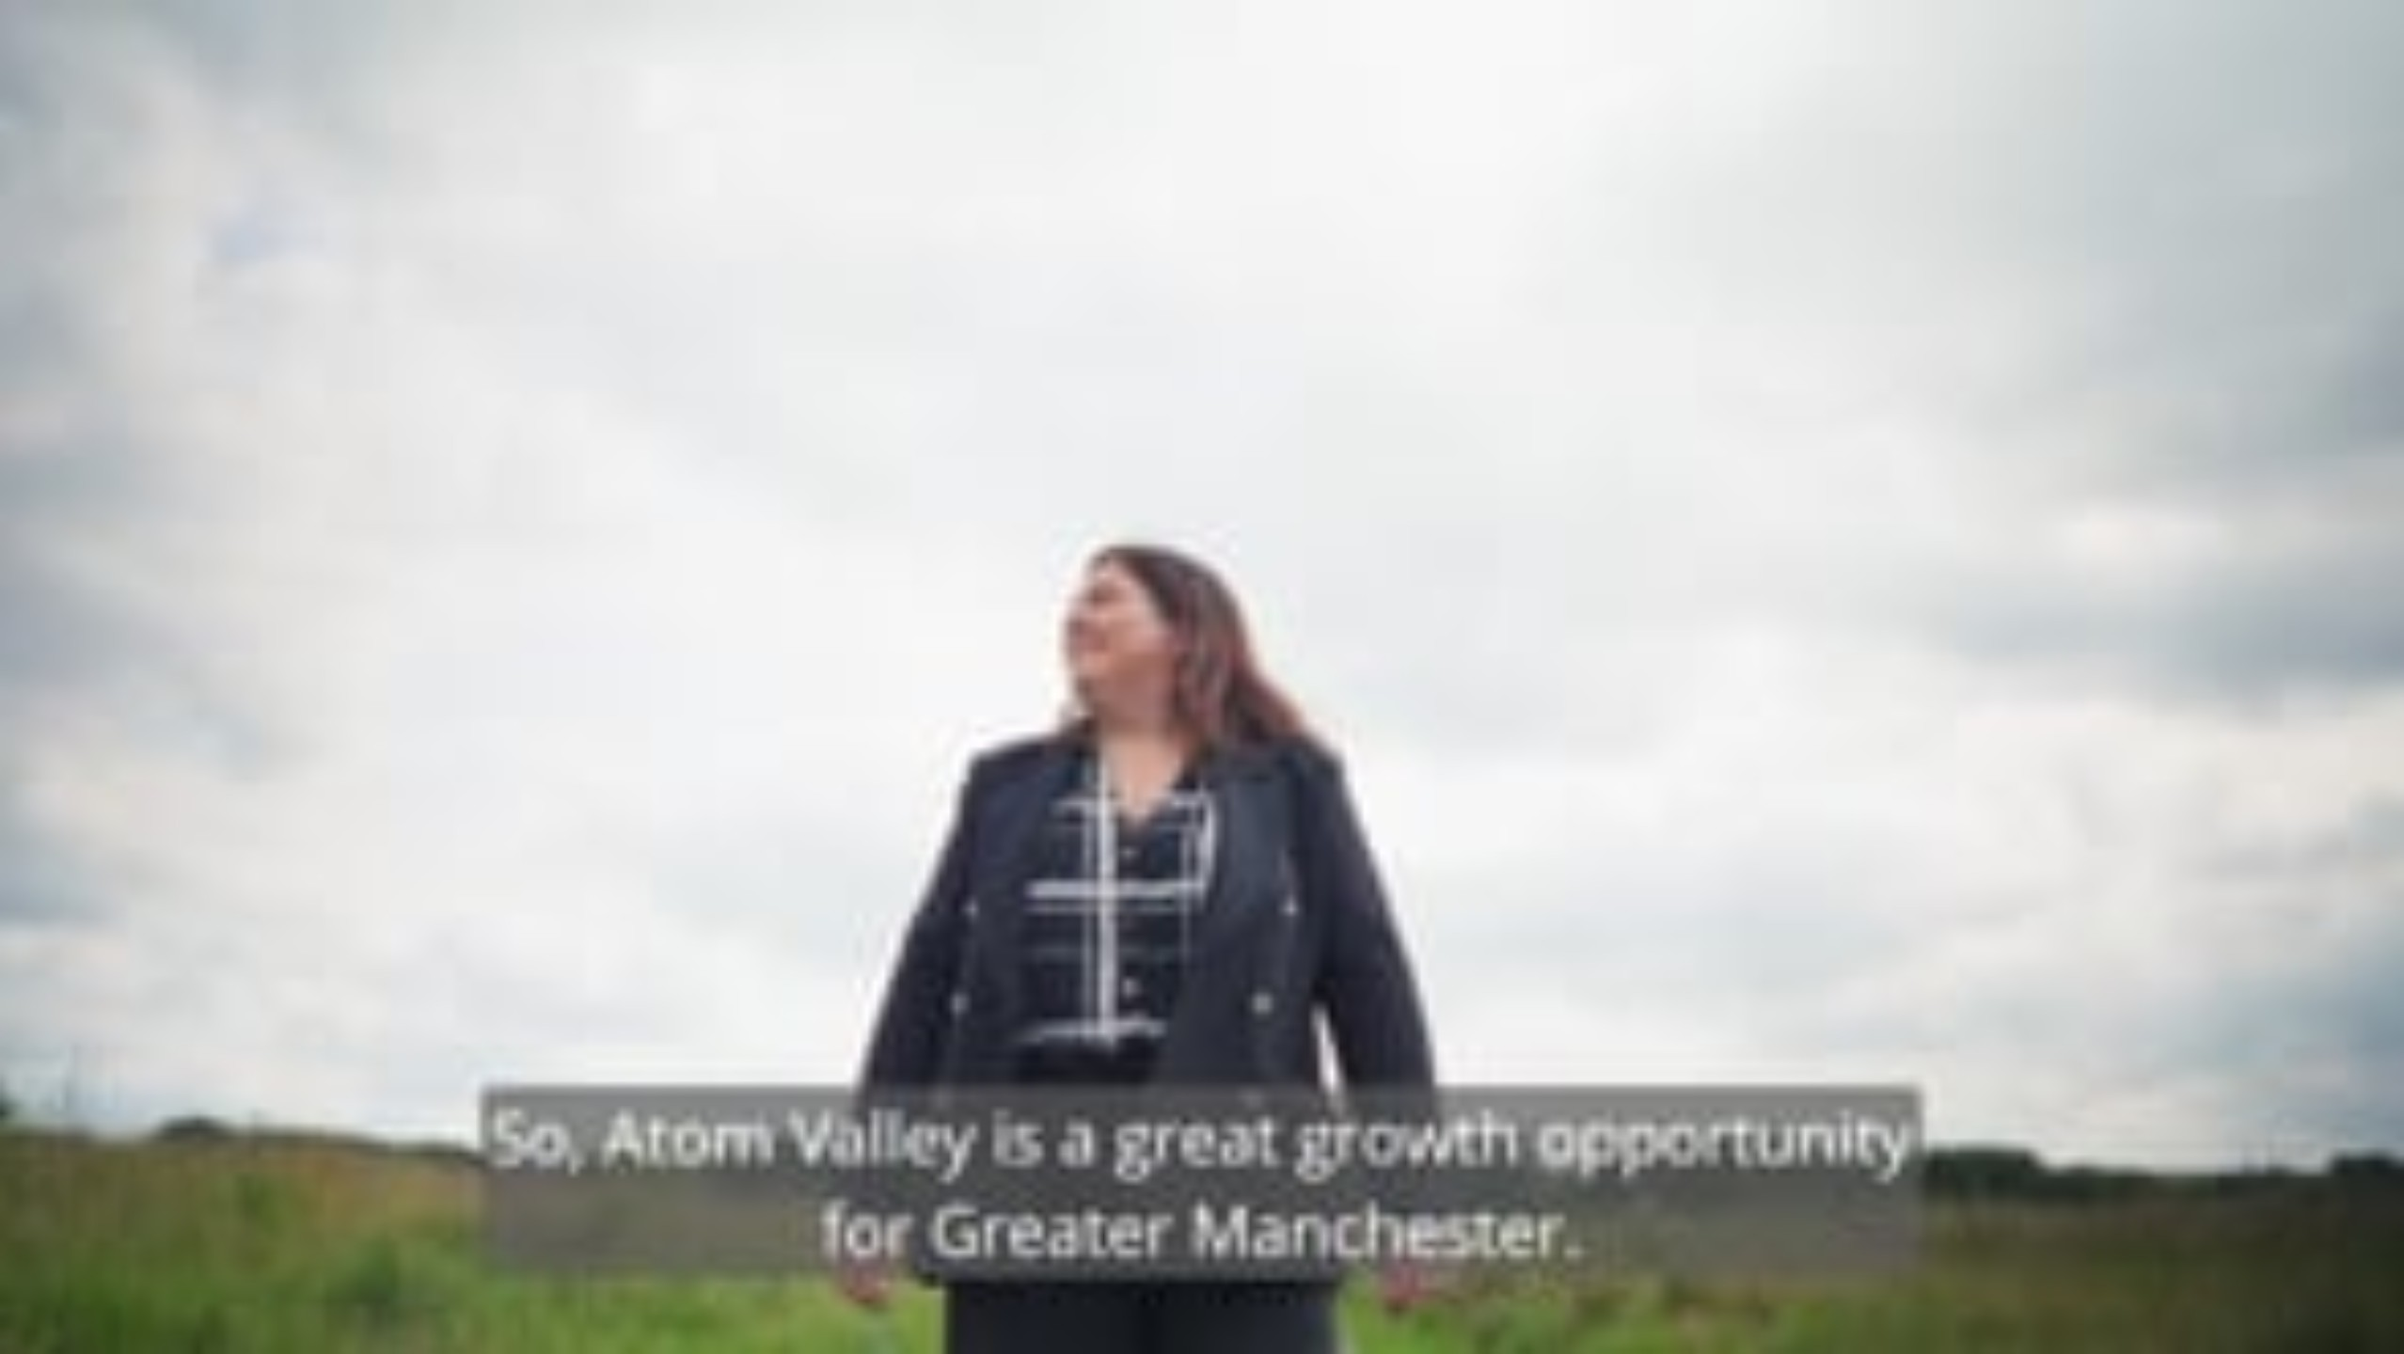
Notes:
VIDEO: Aled came to Manchester for its world-leading materials science sector – and stayed to build a business. His start-up, Dekiln, has developed a more sustainable way to produce tiles, and thanks to the research expertise along the Oxford Road Corridor, he’s taken his idea from lab to launch. It’s business leaders like him who’ll benefit from Atom Valley, a new hub for innovation in advanced materials and manufacturing at sites across Bury, Oldham and Rochdale. Michelle McHugh from Rochdale Development Agency shares the vision: a place where spin-outs scale up, SMEs find space to thrive, and global companies build the future.

Slide 43


Slide 44
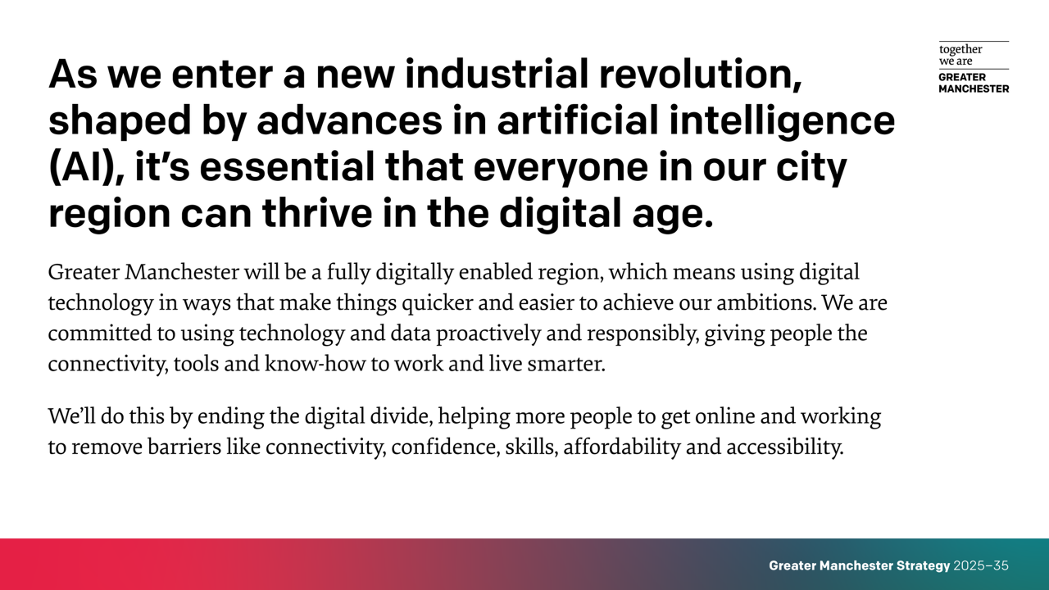

Slide 45
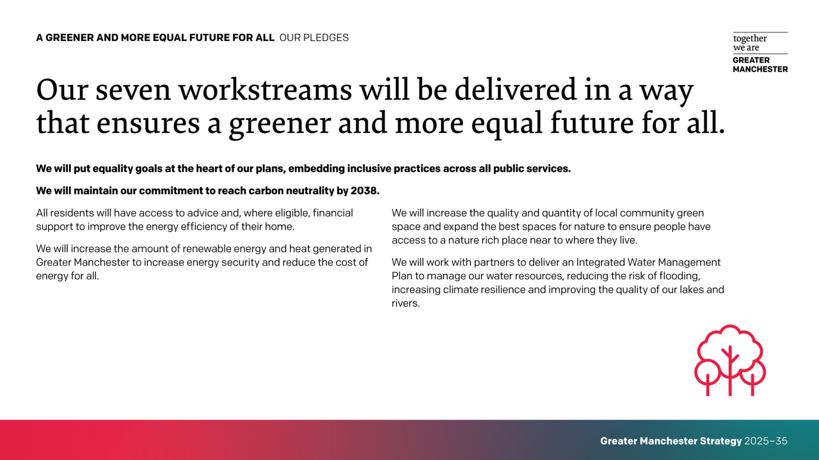

Slide 46
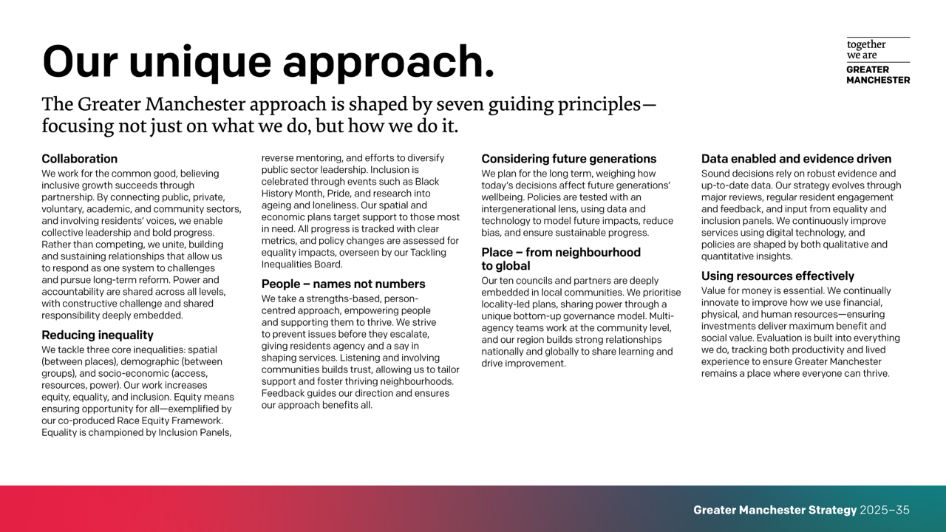

Slide 47
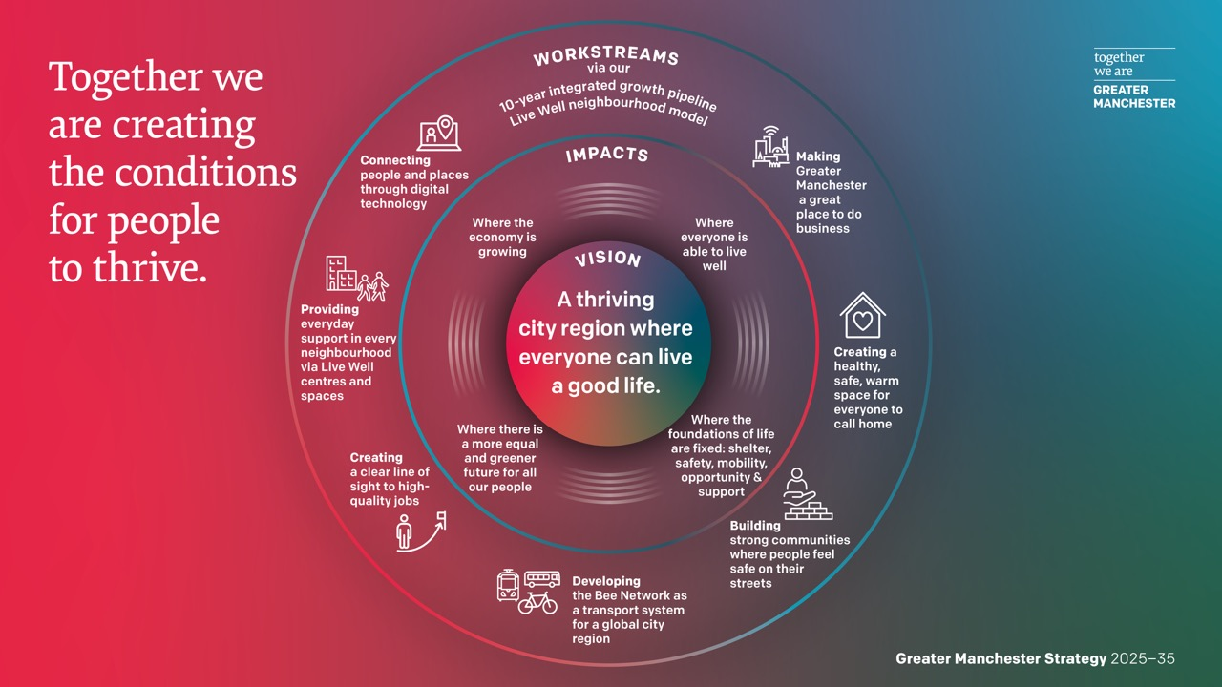

Slide 48

Notes:
ANIMATION: Over the next decade, we’re building a Greater Manchester where everyone can live a good life. Our collective vision for the next decade is a thriving city region where everyone can live a good life. It’s a once-in-a-generation chance to tackle inequalities, empower communities, and deliver public services that truly work for people. By working together, we’ll grow an inclusive economy that creates better jobs, attracts world-class talent, and boosts wellbeing for all, not just growth for growth’s sake, but growth that changes lives. We’ll make our vision happen by doing two things side by side: growing our economy and making sure everyone has what they need to live a happy, healthy life.

Slide 49


Slide 50
